Slide 1
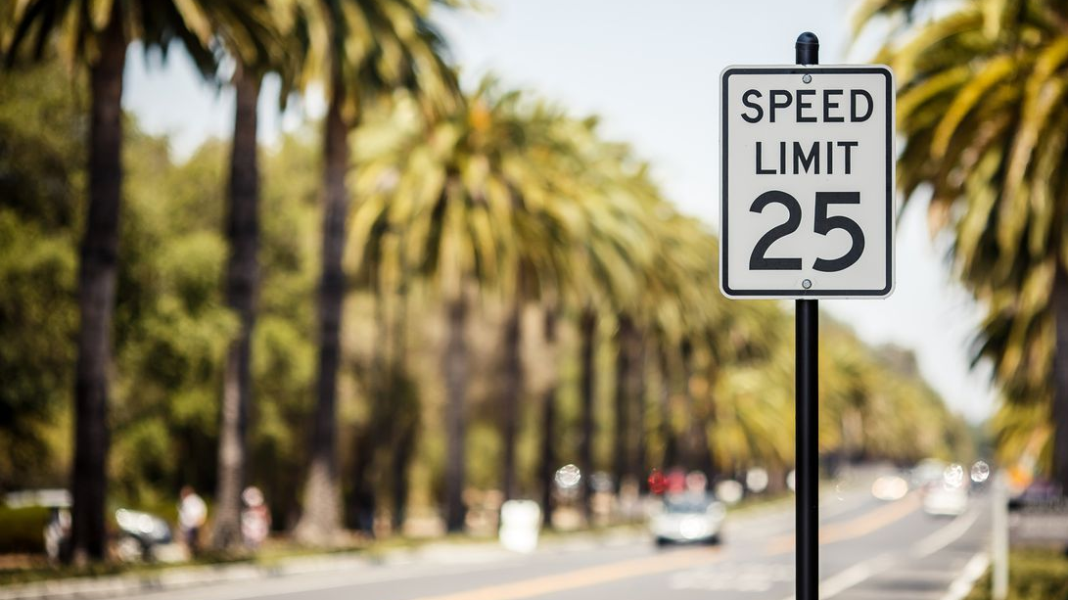
DATA VISUALIZATION Traffic violation in Maryland
By:
AAINA MALHOTRA
POONAM SANJEEV GUGGARI
PRIYA SINGH

Slide 2
INTRODUCTION
Traffic violation occur when drivers of vehicles violate traffic laws enforced by the government. The traffic tickets are generally provided for moving vehicles like speeding, inappropriate parking, Drinking under the influence and reckless driving.
In this analysis, we have used number of traffic violation records and types of violation as a dependent variables.

Slide 3


Data source
DATA.GOV is a U.S. government website which aims to provide public access to machine-readable datasets which is generated by Federal Government.
This dataset contains traffic violation information from all electronic traffic violations issued in the Montgomery County of Maryland.

Slide 4
ISSUES RELATED to TRAFFIC violation
Maryland is one of the states which has the worst traffic as per the given article http://www.baltimoresun.com/news/maryland/baltimore-city/bs-MD-commute-times-20180510-story.html due to an increase in jobs and overall population have increased
In this article http://www.fox5dc.com/news/local-news/more-than-32-000-citations-issued-to-drivers-for-illegally-passing-montgomery-county-school-buses it says that almost 32,000 citations have been issued to drivers for illegally passing Montgomery county school buses during 2017 – 2018 in Bethesda, Md.
Bethesda and Silver Spring are home to seven of Montgomery County’s 10 most congested transportation corridors as per the given article https://bethesdamagazine.com/Bethesda-Beat/2017/Majority-of-Countys-Most-Backed-up-Thoroughfares-in-Bethesda-Silver-Spring/

Slide 5
RESEARCH QUESTION
What is the trend in a number of traffic violations from 2012 to 2018?
What is the most common type of traffic violation?

Slide 6
Sub questions:
Which type of vehicle has been mostly involved in violating the traffic?
What are the various types of arrest for violating the traffic?
Which city has the highest number of traffic violation and fatalities in Maryland?
What are the reasons for a traffic violation?
Which city had the highest number of fatalities?
Which gender and race are highly involved in violating the traffic?
Which gender has been involved in Drinking under influence cases?
Does the traffic violation has resulted in any personal injury or property damage?
Does the traffic is violated during weekends or weekdays because of DUI and at what time?
At what time of year(month) traffic is mostly violated? Is it during Vacation time?

Slide 7
FACTORS affecting the dependent variable
FACTORS | DESCRIPTION
DATE | Date when violation occurred
TIME | Time when violation occurred
VIOLATION TYPE | Types of violations
SEAT BELT | If driver had belt at time of violation (Yes, NO)
DRINKING UNDER INFLUENCE | If Driver was DUI at time of violation (Yes, No)
Gender of driver (M,F) | Gender of driver (M,F)
ARREST TYPE | Type of arrest
RACE | Race of driver (M,F)
DRIVER CITY | City of driver
STATE | State of driver
PERSONAL INJURY | if any personal injury OCCURRED( YES. NO)
PROPERTY DAMAGE | if any property damaged(YES,NO)
FATALITIES | if any FATALITIES OCCURRED(YES,NO)
VEHICLE TYPE | TYPE OF VEHICLE
The number of records and types of violations will be studied against with various factors given in table 1.
TABLE 1

Slide 8
Statistical summary of data
City | Number of records
SILVER SPRING | 343228
GAITHERSBURG | 140892
GERMANTOWN | 112559
ROCKVILLE | 112453
WASHINGTON | 42247
BETHESDA | 37049
MONTGOMERY VILLAGE | 36759
HYATTSVILLE | 31711
POTOMAC | 27241
OLNEY | 23866
LAUREL | 19318
FREDERICK | 18686
CLARKSBURG | 17592
TAKOMA PARK | 14801
NORTH POTOMAC | 14534
KENSINGTON | 14442
DAMASCUS | 13627
BURTONSVILLE | 12980
BELTSVILLE | 12306
CHEVY CHASE | 11090
BALTIMORE | 10413
In our dataset, we had 35 variables and 10 lakh observations. This dataset consists of data from 2012 to 2018. We have 1,299,794 observations, and 20 variables.
In table 1, these are the top cities having traffic violation records in Maryland.
TABLE 11 – Cities in Maryland with traffic violation records from 2012 - 2018

Slide 9
Statistical summary of data
City | Number of damages record
SILVER SPRING | 5524
GAITHERSBURG | 1624
ROCKVILLE | 1468
GERMANTOWN | 1009
City | Number of records
Citation | 551756
ESERO | 60006
SERO | 776
Warning | 590563
Table 2, shows the number of damages occurred in Cities of Maryland.
Table 3, show that citation is the most common type of violation in the United States.
Table 4, show the number of personal injury in top 5 cities of Maryland
Table 3 – Number of property damages in cities
Table 4 – Number of traffic violation records
City | Number of personal injury records
SILVER SPRING | 2979
GAITHERSBURG | 1003
ROCKVILLE | 882
GERMANTOWN | 787
BETHESDA | 384
Table 5 – Number of personal injury in cities

Slide 10
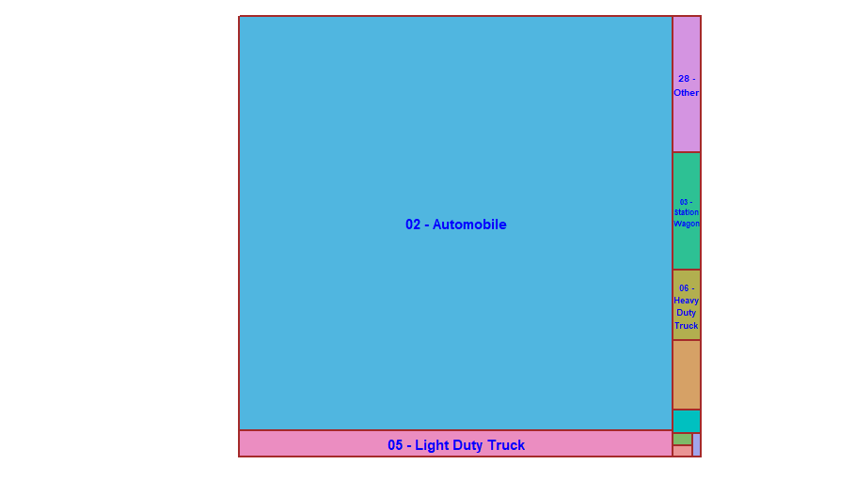
Vehicles involved in Traffic violation
Automobile is the highest in violating the traffic rules
Light duty trucks were also part of traffic violation

Slide 11
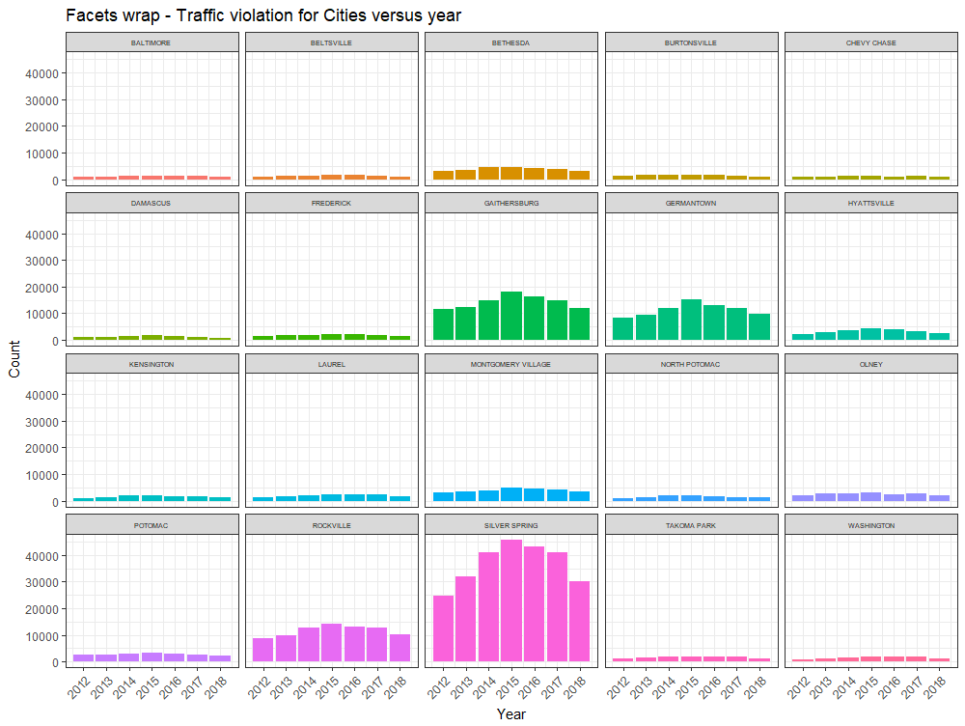
Traffic violation In cities of Maryland
Silver Spring has the highest number of traffic violation in Maryland in 2015.

Slide 12
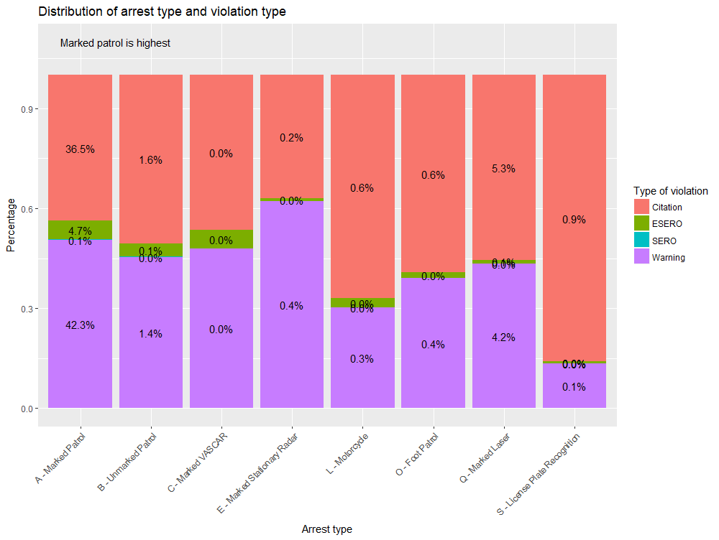
Most common type of traffic violation
In 201I and 2018 ,most common type of Traffic violation is Warning followed by citation.
ESERO and SERO are not very common in United States.

Slide 13
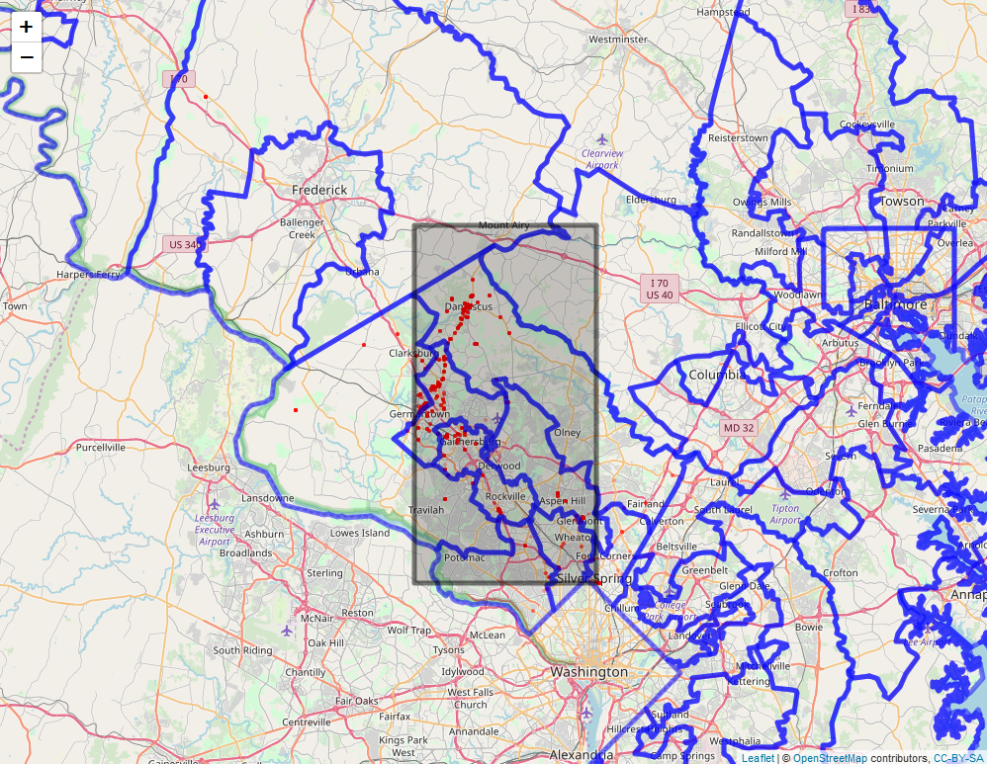
DRINKING UNDER INFLUENCE - Traffic violation LOCATIONS
Germantown and Damascus is said have more number of drinking under influence cases in Maryland

Slide 14
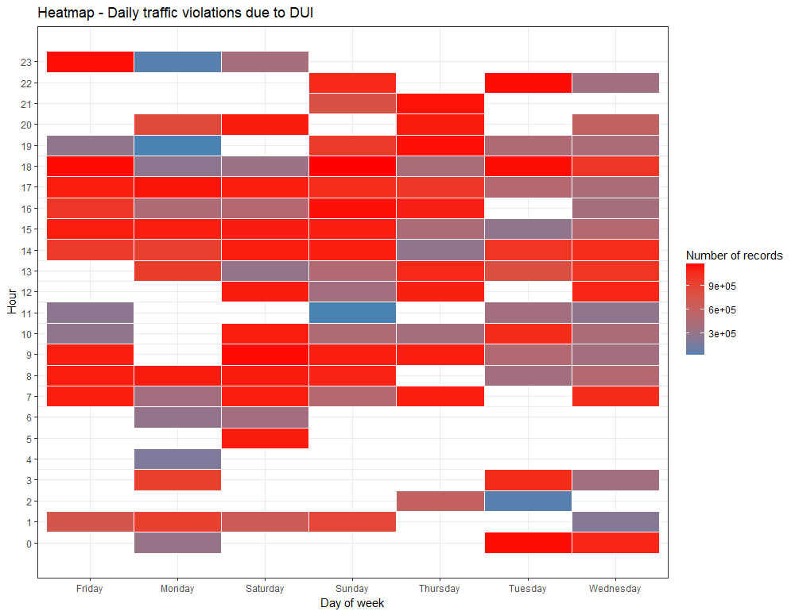
DUI - Daily Traffic violations USING HEATMAP
The red areas represent the times of the day and the days of the week that receive the most reports of traffic violations activity.
We can see that these incidents are concentrated on the weekends and during the weekday late evenings 5pm in all the days of the week is having more number of traffic violation records due to Drinking under influence.

Slide 15
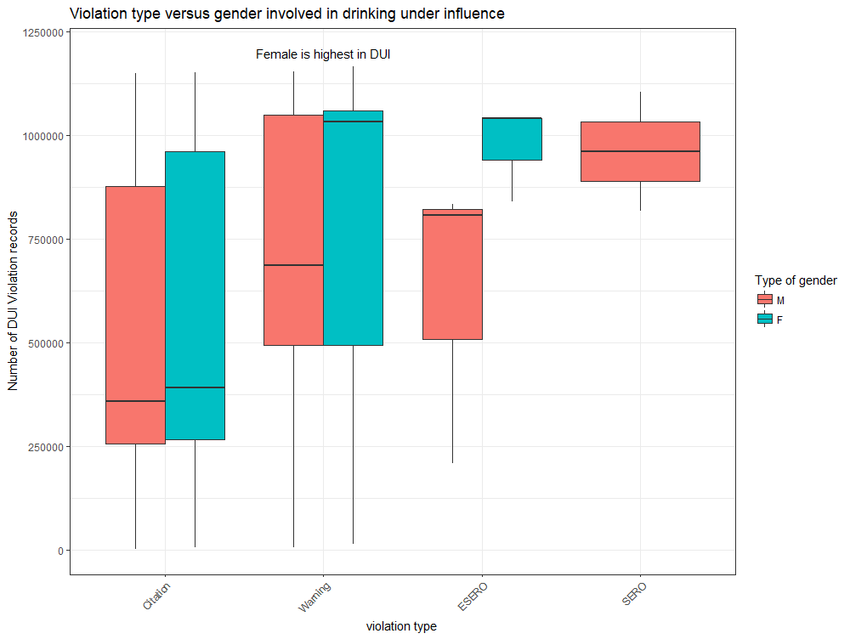
Reasons of traffic ticket - DUI
Female population is highest in Drinking under influence cases.
Drinking under influence cases has been reported mostly in warning and citation.
SERO and ESSERO has been reported more for males

Slide 16
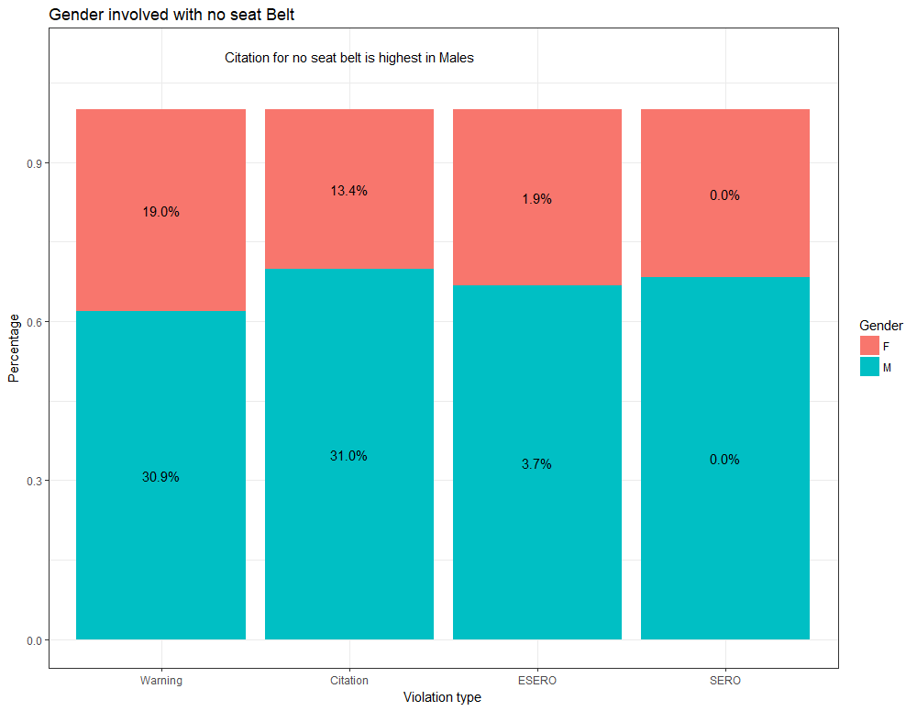
Reasons of traffic ticket – NO SEAT BELT
Males are highest in violating no seat belt traffic rules.
Citations is highest for no seat belt in Males

Slide 17
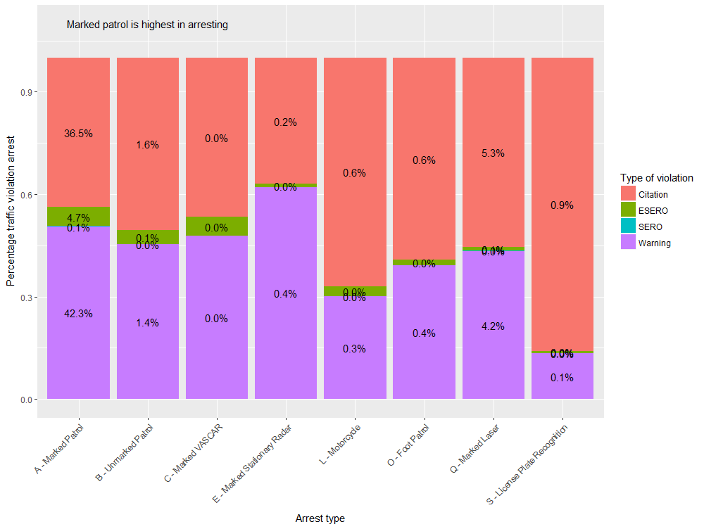
Types of arrest FOR VIOLATING TRAFFIC RULES
The most of the arrest type is Marked patrol, Marked Laser and Motorcycle.

Slide 18
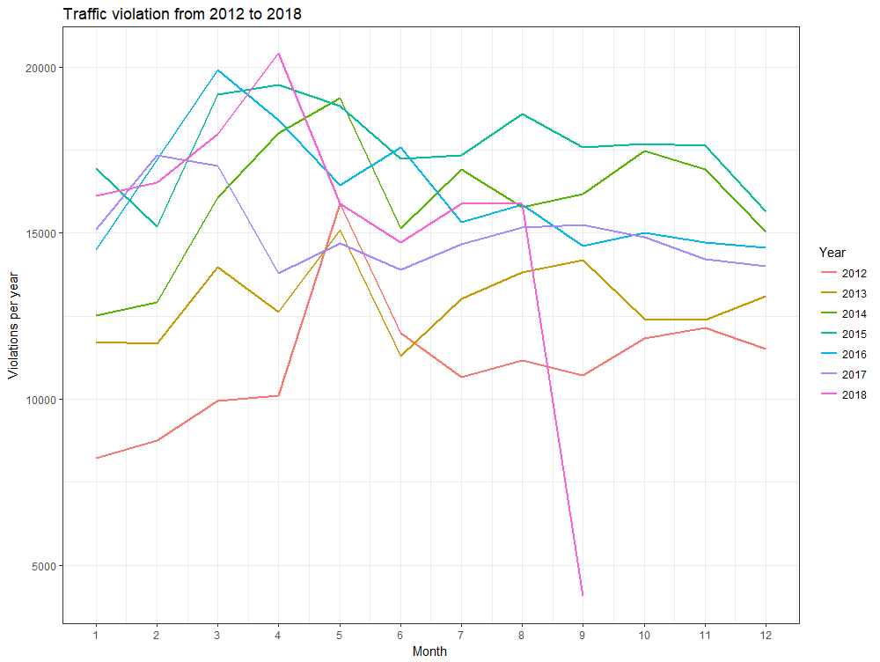
TRAFFIC VIOLATION FROM 2012 - 2018
Traffic violation has been increased in 2016 in the month of March - April.
This year had the highest number of violation in the month of April

Slide 19
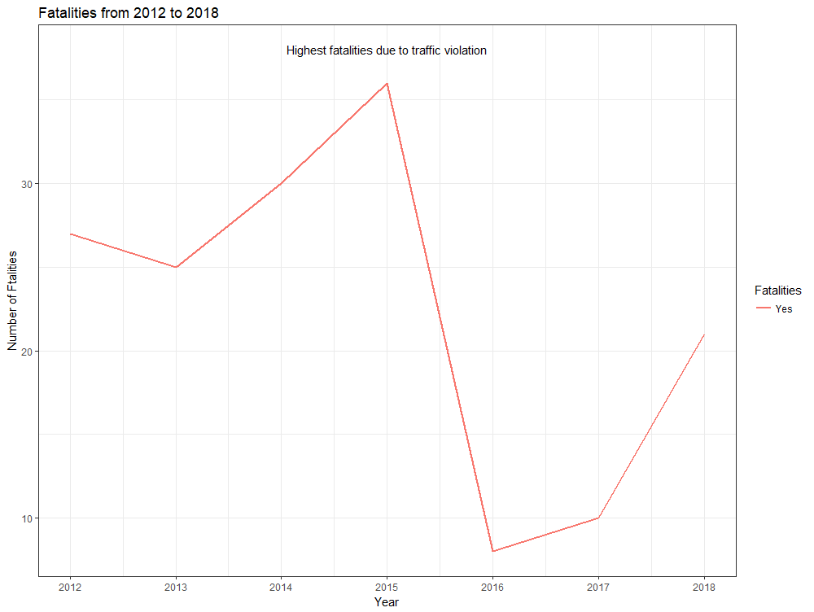
Fatalities caused due to traffic violation
Highest number of fatalities have been caused in year 2015

Slide 20
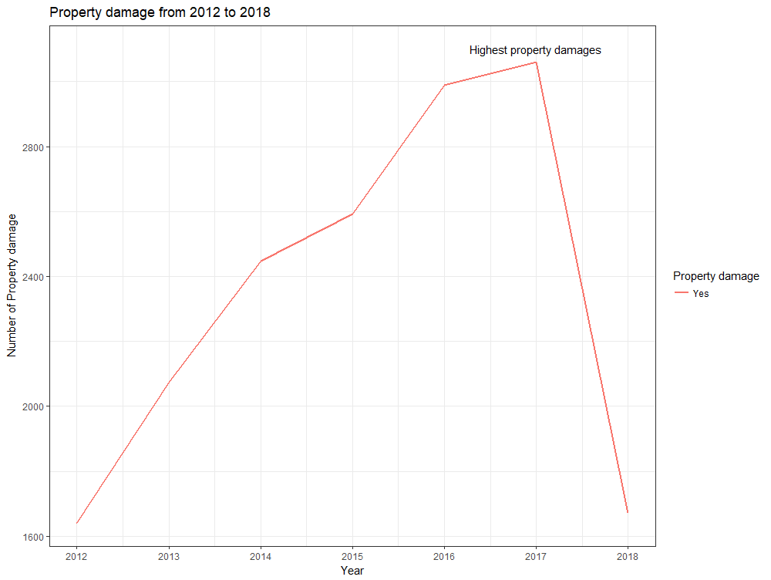
Property damages caused due to traffic violation
The highest number of property damages occurred in year 2017.

Slide 21
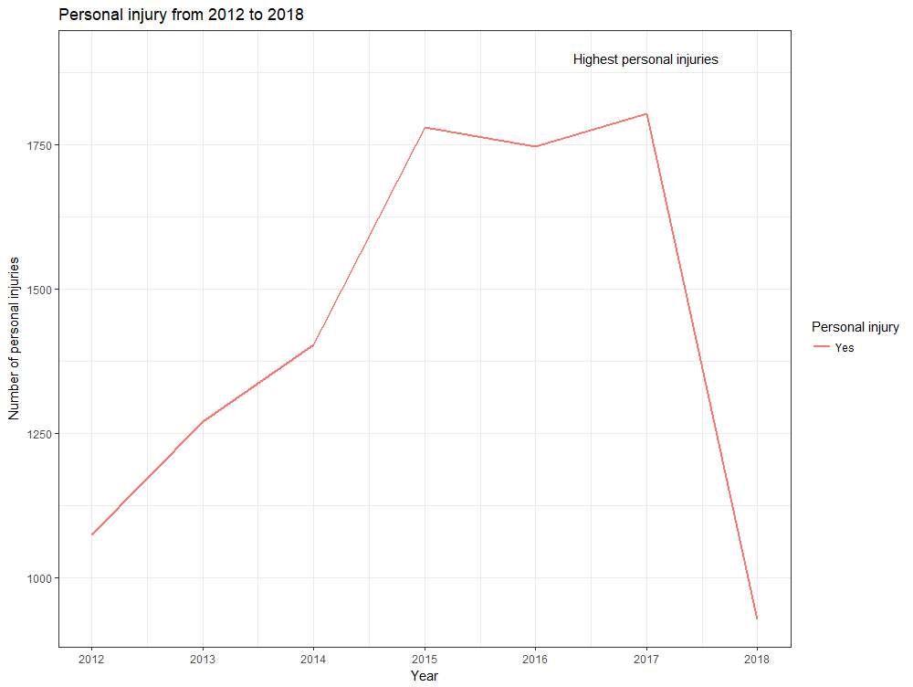
Personal injury caused due to traffic violation
Highest number of personal injuries took place in year 2017

Slide 22
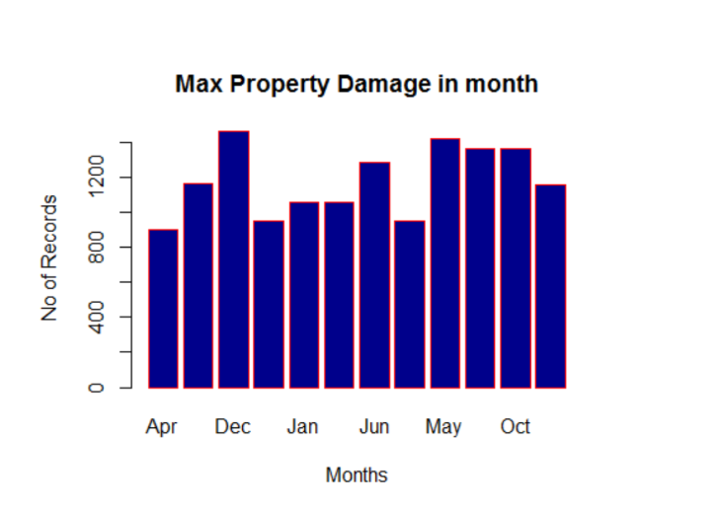
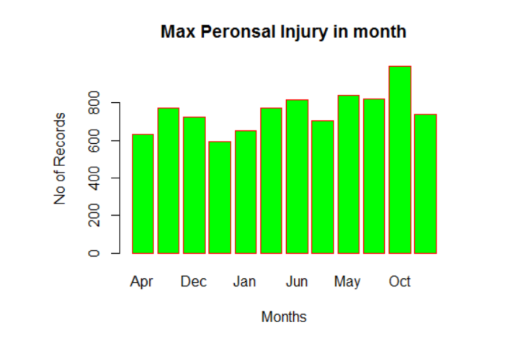
INJURIES AND DAMAGES MONTH WISE
October and December have the highest number of damages and injuries

Slide 23
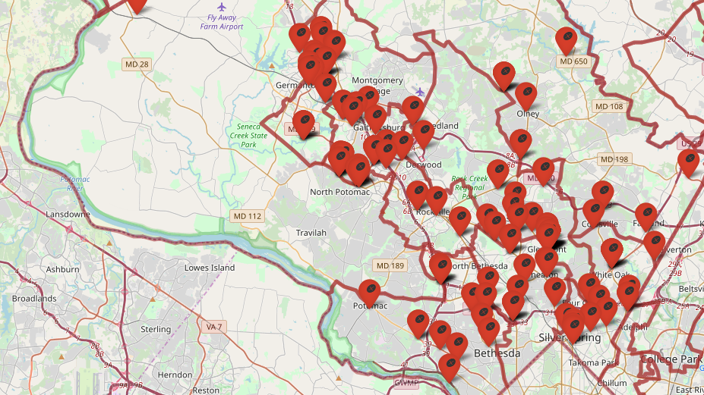
Fatalities in cities of Maryland
The markers show that most of the incidents have been occurred in Silver Spring and Gaithersburg and Germantown.

Slide 24
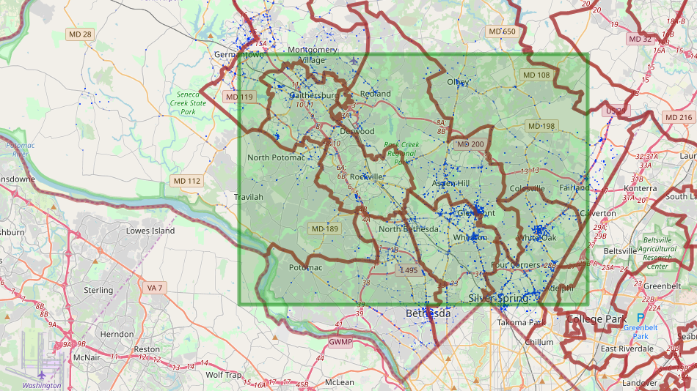
PROPERTY DAMAGE IN CITIES OF MARYLAND
The cities Silver Spring, White Oak, Gaithersburg and Rockville have the highest number of property damage in Maryland.

Slide 25
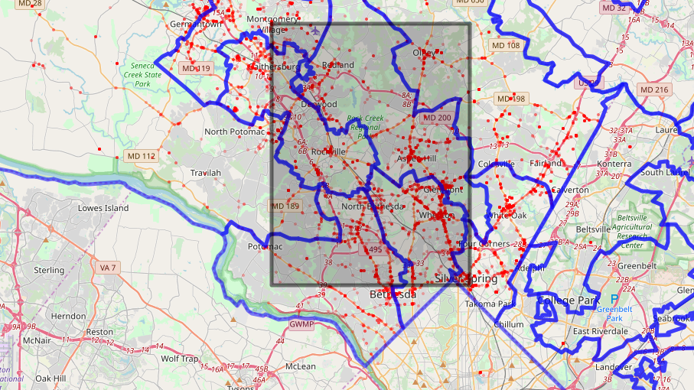
Personal INJURY IN CITIES OF MARYLAND
Most of the incidents have occurred in Silver Spring, Gaithersburg, Rockville and Germantown

Slide 26
CONCLUSION
Silver Spring had a number of fatalities, personal injuries and property damages.
Most of the incidents took place in the year 2016 and also in 2018 in the month of April
Most of the violations have constantly occurred during vacation time.
Drinking under influence took place generally during the weekends and between 3pm – 10pm.
Marked patrol is the most common type of arrest in arresting for violating the traffic
Males have been more involved in violating traffic
Female count in drinking under influence is more than males.
Silver Spring has the highest number of a traffic violation in Maryland.
In this study, we have analyzed that this data can be used to reduce traffic violation in future and understanding the causes.

Slide 27
CHALLENGES
The first challenge is that all of the variables are categorical and not continuous.
There was a limitation in choosing graphs for categorical data.
We have relied on the “count” of violations variable as the dependent variables and grouped it with each category.
The dataset is huge and hence we had to subset the data.
To map the locations in leaflets we had to subset the data for various variables.

Slide 28
REFERENCES
Data.gov. (n.d.). Retrieved from https://www.data.gov/
Traffic Violations. (2018, August 09). Retrieved from https://catalog.data.gov/dataset/traffic-violations-56dda
Campbell, C. (2018, June 18). 'The traffic is horrible': Baltimore commute ranks among nation's longest. Retrieved from http://www.baltimoresun.com/news/maryland/baltimore-city/bs-md-commute-times-20180510-story.html
WTTG. (n.d.). More than 32,000 citations issued to drivers for illegally passing Montgomery County school buses. Retrieved from http://www.fox5dc.com/news/local-news/more-than-32-000-citations-issued-to-drivers-for-illegally-passing-montgomery-county-school-buses
Majority of County's Most Backed-up Thoroughfares in Bethesda, Silver Spring. (2017, February 10). Retrieved from https://bethesdamagazine.com/Bethesda-Beat/2017/Majority-of-Countys-Most-Backed-up-Thoroughfares-in-Bethesda-Silver-Spring/
Aesthetic specifications. (n.d.). Retrieved from https://ggplot2.tidyverse.org/articles/ggplot2-specs.html
(n.d.). Retrieved from https://rstudio.github.io/leaflet/?Name=Leaflet for R (required reading)
(n.d.). Retrieved from http://www.cookbook-r.com/Graphs/Facets_(ggplot2)/#facetwrap

Slide 29
QUESTION AND ANSWERS?

